Slide 1
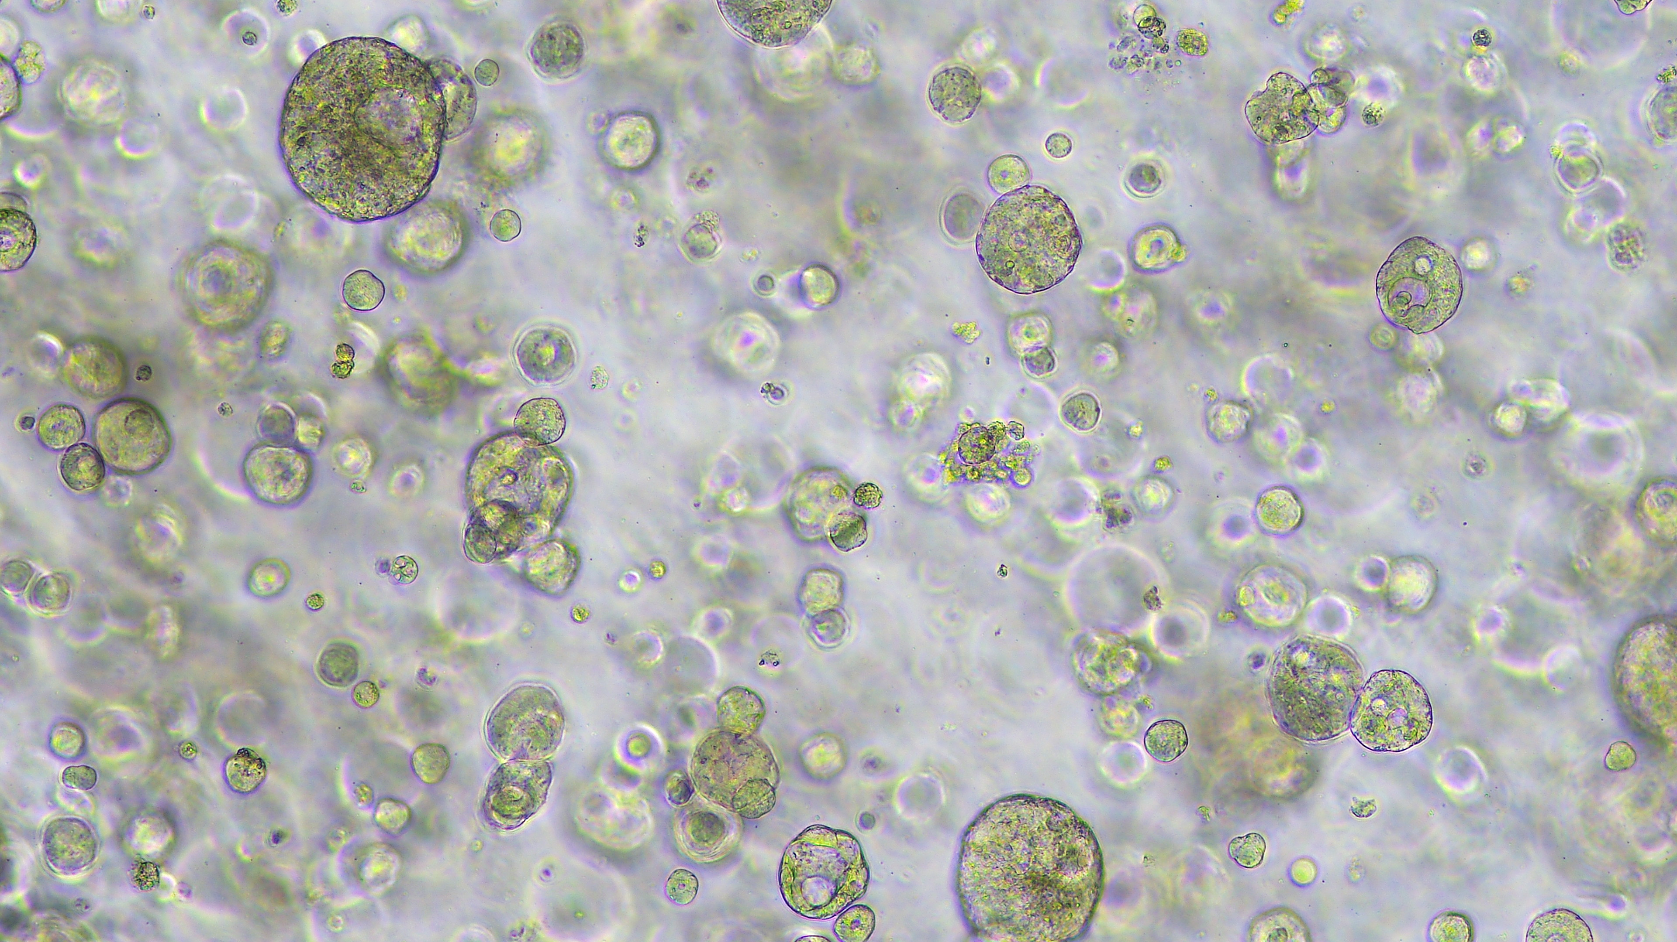
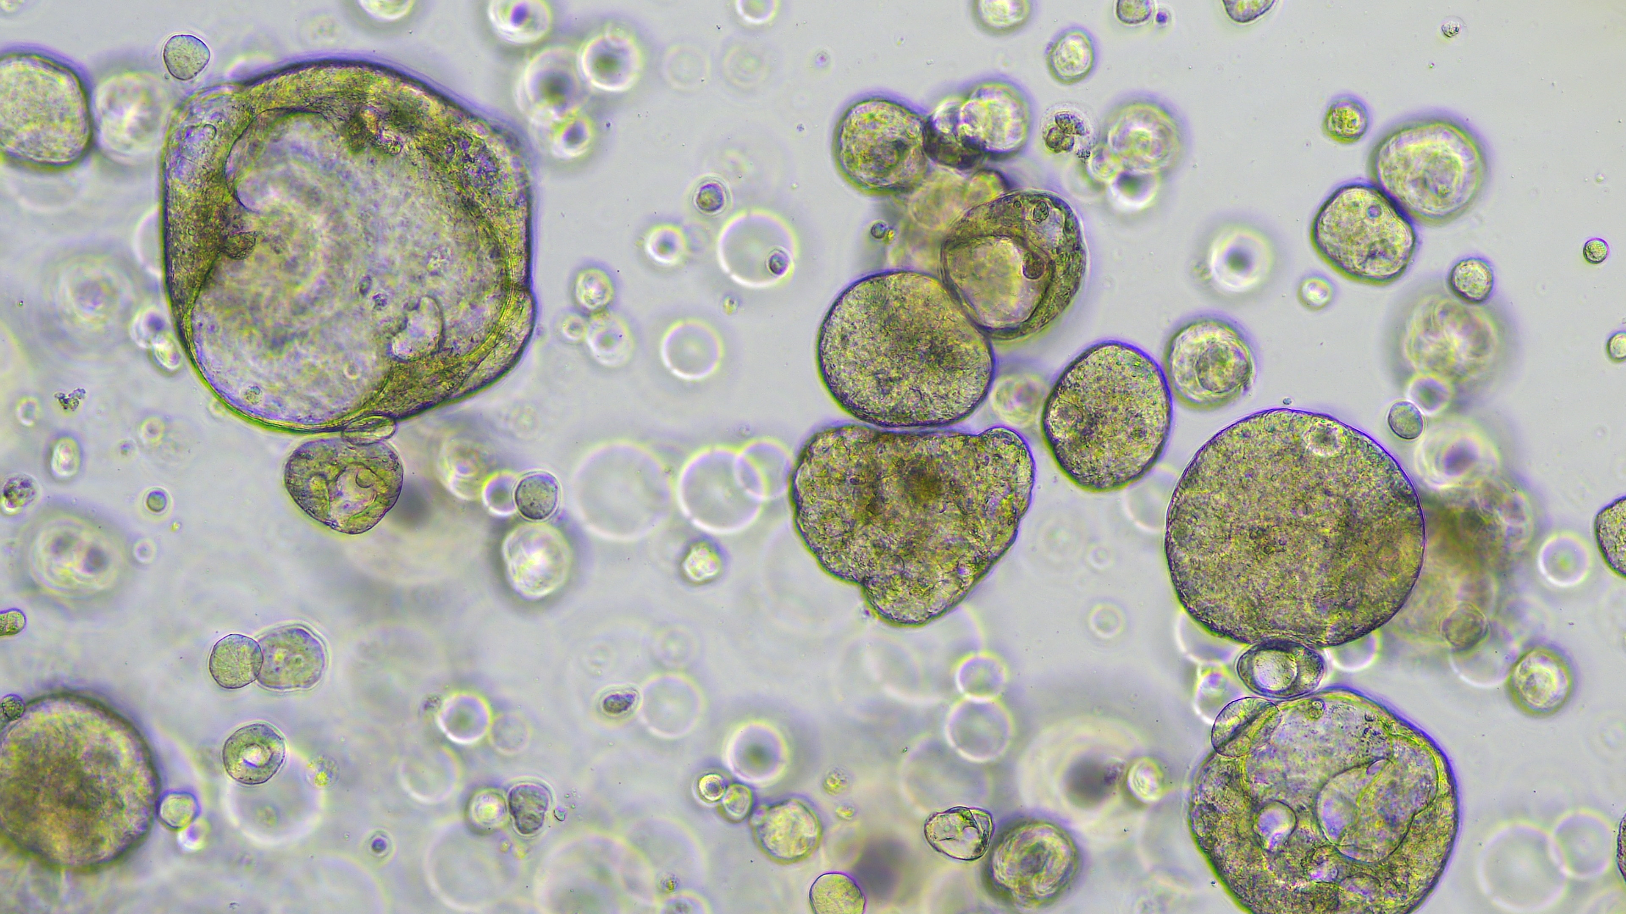
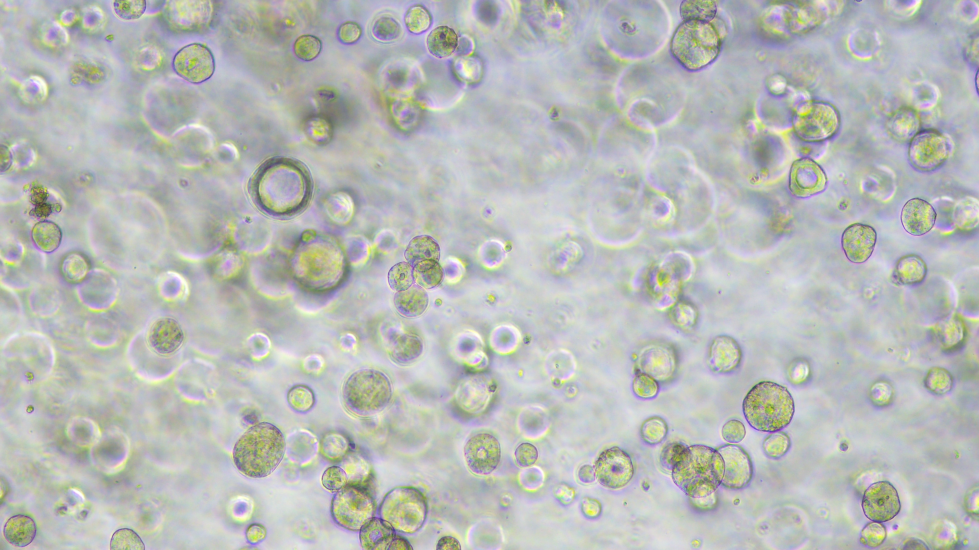
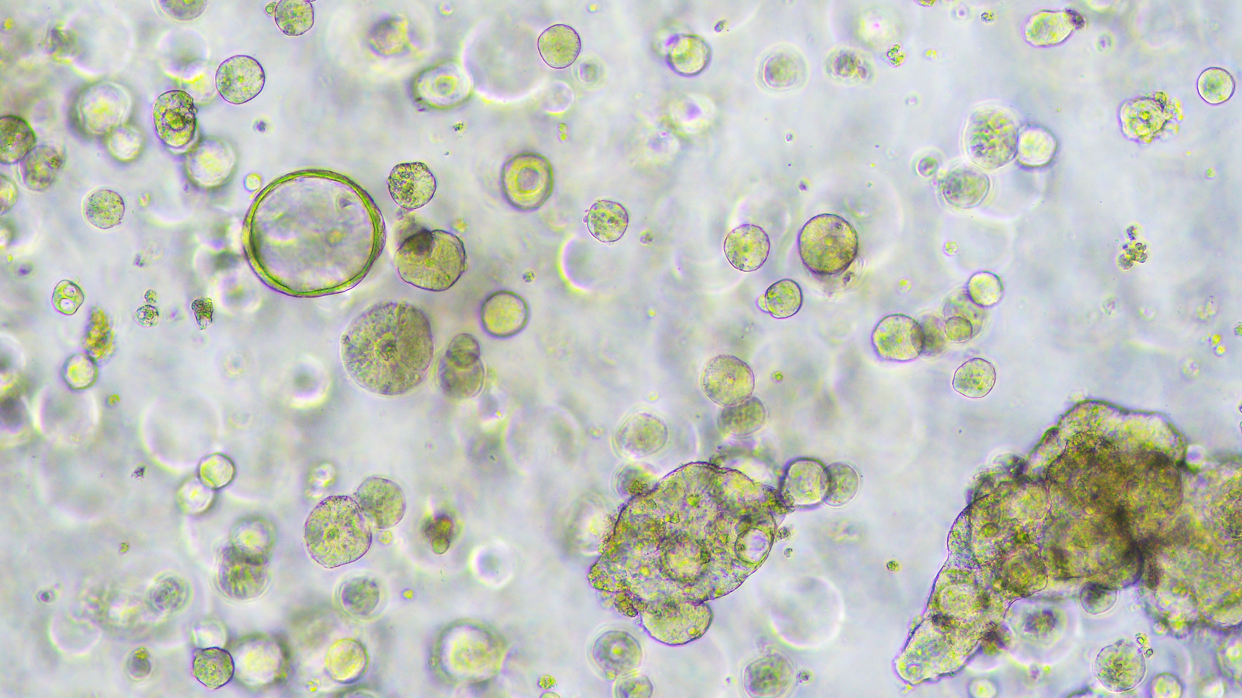
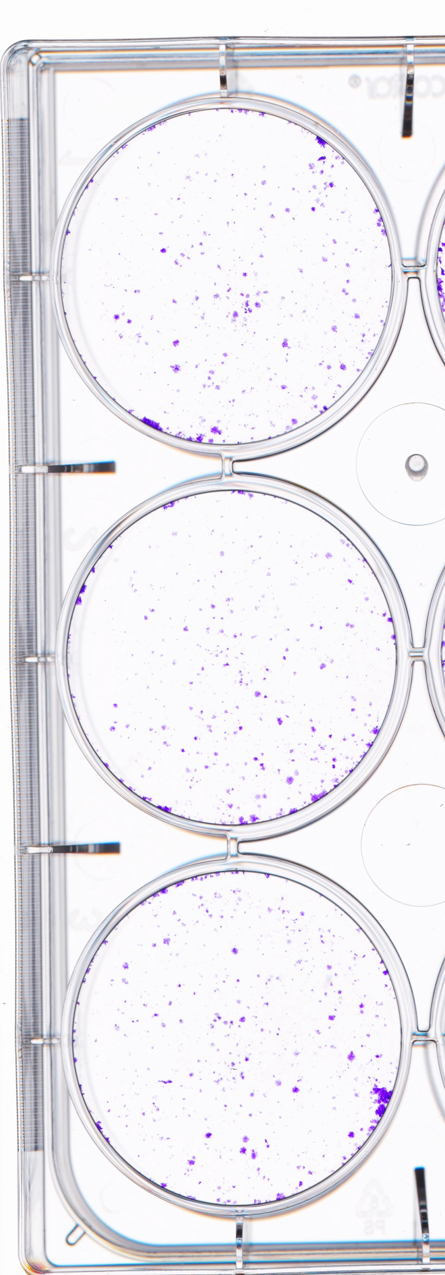
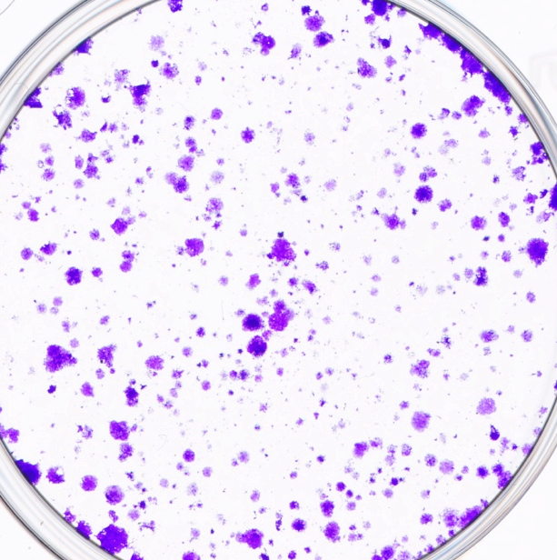
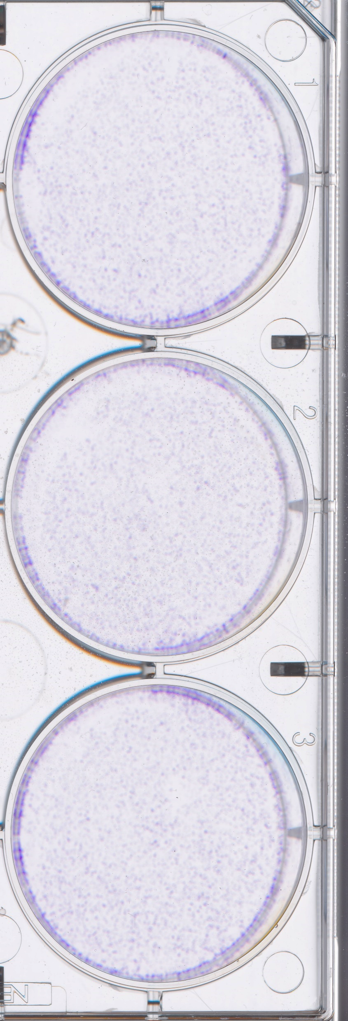
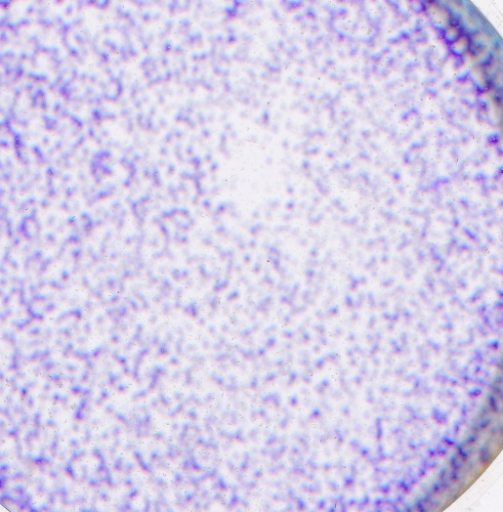
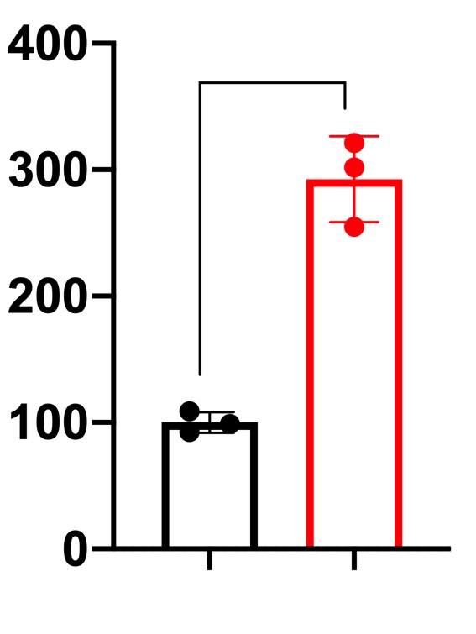
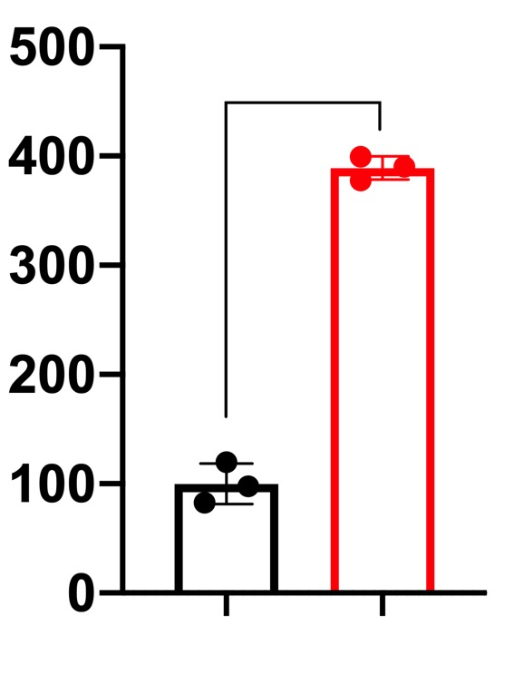
Figure 2
a
c
SDB
A. r CM
NCM460
SW480
HT29
P=0.0018
P=0.0046
P=0.0004
SDB
Cell viability
(Absorbance OD=570nm)
Cell viability
(Absorbance OD=570nm)
Cell viability
(Absorbance OD=570nm)
A. r CM
Organoid 828
Time ( hrs )
Time ( hrs )
Time ( hrs )
SW480
HT29
Organoid 816
b
SDB
A. r CM
SDB
A. r CM
P<0.0001
P<0.0001
P=0.0007
P<0.0001
Colony formation
(% of control)
Colony formation
(% of control)
Surface area ( 10⁴ µm² )
Surface area ( 10⁴ µm² )
CTRL
A.R
SDB
A. r CM
CTRL
A.R
SDB
A. r CM
SDB
A. r CM
SDB
A. r CM

